Slide 1

Learning Objective
I will solve contextual/worded linear equations.
Enter quietly, please be ready with the following on your desk:
Whiteboard
Whiteboard marker
Exercise Book
Pencil, pen, ruler and red pen
Diary
Calculator
Device – charged or borrowed from Library before maths

Slide 2
Learning Objective
I will solve contextual linear equations.
Success Criteria
At the end of the lesson, I will be able to:
Use inverse operations to rearrange equations
Rearrange equations to solve unknown variables

Slide 3
Concept Development
Solving problems using linear equations involves the following steps:
Step 1: Use a variable to define an unknown value
Step 2: Form an equation using the key words in the stated problem and the variable
Step 3: Solve the equation using inverse operations
Step 4: Answer the question in words
Step 5: Check your answers make sense and satisfy all conditions of
the problem

Slide 4
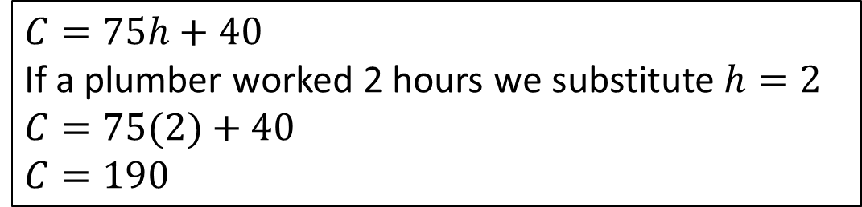

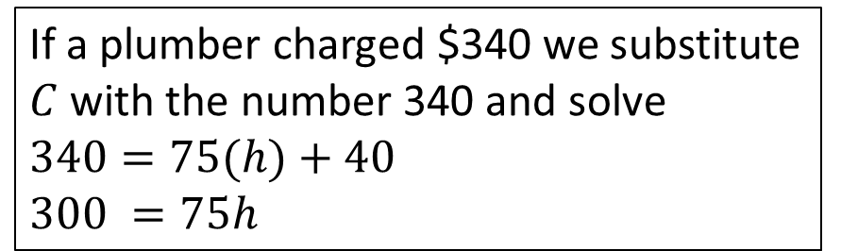
Skill Development
A plumber has a call out fee of $40, plus an hourly rate of $75.
Write a formula to calculate the cost of any job.
Calculate the cost of a job estimated to take 2 hours.
Calculate the numbers of hours work if the plumber charged a total cost of $340
Which number is constant and which is the rate of change?
$40 is constant and $75 is the rate per number of hours worked.
Let the total cost = $C$ Number of hours worked = $h$
$$C=75h+40$$
If a plumber worked 2 hours we substitute $h=2$
$$C=75(2)+40$$
$$C=190$$
If a plumber charged $340 we substitute $C$ with the number 340 and solve
$$340=75(h)+40$$
$$300 =75h$$
The cost charged by the plumber for a job estimated to take 2 hours is $190
$$4 =h$$
The plumber worked 4 hours for a job costing a total of $340

Slide 5
Guided Practice
Find 3 consecutive even numbers whose sum is 126

Slide 6
Guided Practice
Sam divided his bag of lollies so that he and his friends, Nikki and Min could share them.
He gave himself twice as many as he gave Nikki, and Min received 3 times as many as Nikki.
If the bag contained 42 lollies, how many did each person receive?

Slide 7


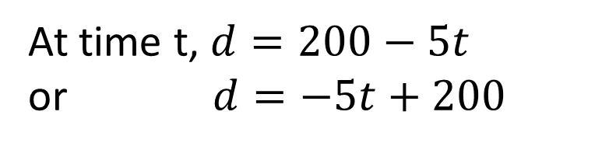


Guided Practice
At $t=0, d=200km$
As he walks, the distance the man is from Town B is getting smaller
Distance travelled = Speed x Time
Speed $=5km /h$
Distance man travelled = $5t$
At time t, $d=200−5t$ or $d=−5t+200$

Slide 8
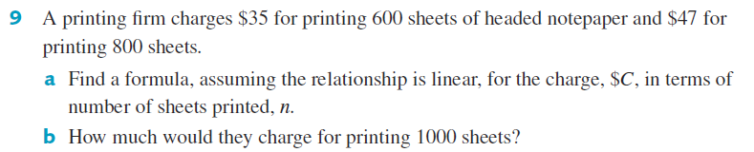
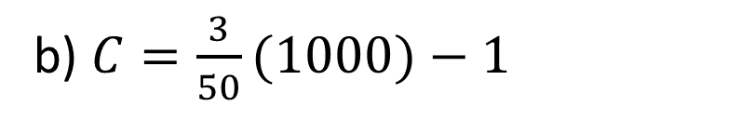
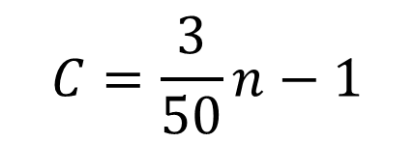
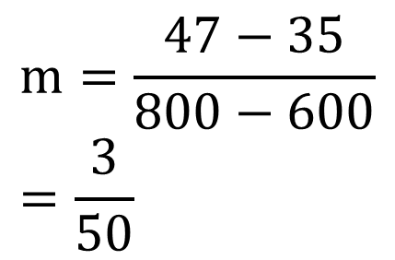

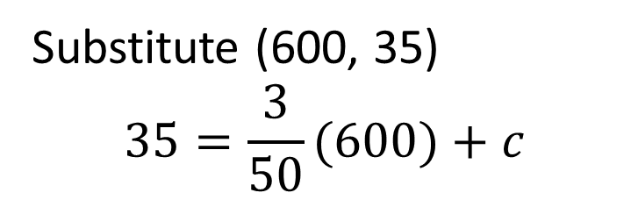

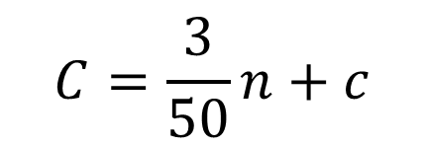
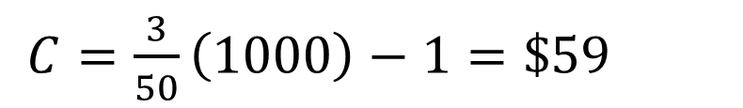
Guided Practice
a) Two coordinates (n, $C): (600, 35) (800, 47)
$$m=\frac{47−35}{800−600} \\ =\frac{3}{50}$$
$$c=−1$$
$$C=\frac{3}{50}n−1$$
$$C=\frac{3}{50}n+c$$
b) $C=\frac{3}{50}(1000)−1$
Substitute (600, 35)
$$35=\frac{3}{50}(600)+c$$
$C=\frac{3}{50}\left(1000\right)−1=\$59$
They charge $\$59$

Slide 9
Independent Practice
Complete Cambridge Ex 2G

